Slide 1
ASHWANTH R
Final Project
3/21/2024 Annual Review

Slide 2
FACIAL LANDMARK DETECTION USING RESNET18
3/21/2024 Annual Review

Slide 3


AGENDA
Data Preparation :
Collection and preprocessing of facial image data.
Model Implementation :
Introduction to ResNet50 architecture for landmark detection.
Training :
Details of model training process on CIFAR-10 dataset.
Evaluation :
Assessment of model performance using test data.
Optional Fine-Tuning :
Adjustment of hyperparameters for optimization.
Deployment :
Strategies for real-world application of trained model.
3/21/2024 Annual Review

Slide 4

PROBLEM STATEMENT
Facial landmark detection, a crucial task in computer vision, finds applications in facial recognition, expression analysis, and augmented reality. This study proposes a deep learning-based approach for facial landmark detection, leveraging a Resnet18 architecture tailored for this task. Annotated facial image datasets are utilized for training and validation, with data augmentation techniques enhancing robustness. Experimental results showcase the effectiveness of the approach in accurately localizing facial landmarks across diverse conditions, achieving state-of-the-art performance. The method's potential for real-world applications in facial analysis and biometric systems is demonstrated, contributing to advancements in facial landmark detection with implications for human-computer interaction, healthcare, and security domains.
3/21/2024 Annual Review

Slide 5

PROJECT OVERVIEW
This project presents a deep learning-based approach for facial landmark detection, crucial in various computer vision applications like facial recognition and augmented reality. Leveraging a specialized Resnet18 architecture, the method accurately localizes facial landmarks using annotated datasets and employs data augmentation techniques for robustness. Experimental results demonstrate state-of-the-art performance across diverse conditions, showcasing its potential for real-world applications in facial analysis and biometric systems, thereby advancing the field of facial landmark detection with implications for human-computer interaction, healthcare, and security domains.
3/21/2024 Annual Review

Slide 6

WHO ARE THE END USERS?
Biometric Systems Developers: Companies creating systems for identity verification and authentication.
Facial Recognition Software Providers: Developers of software for security, surveillance, or access control.
Augmented Reality (AR) Application Developers: Creators of AR apps for gaming, entertainment, or virtual experiences.
Healthcare Professionals: Medical professionals using facial landmark detection for imaging analysis and diagnosis.
Human-Computer Interaction (HCI) Researchers: Scientists studying interactions between humans and computers.
Forensic Analysts: Experts in forensic science using facial landmark detection for identification and analysis.
Retail and Marketing Companies: Businesses utilizing facial landmark detection for customer analytics and targeted advertising.
3/21/2024 Annual Review

Slide 7

YOUR SOLUTION AND ITS VALUE PROPOSITION
Solution:
Deep learning-based approach using CNN architecture.
Training with annotated datasets and data augmentation.
Robust detection across diverse facial conditions.
State-of-the-art performance in facial landmark detection.
Value Proposition:
Reliable and accurate detection for various applications.
Versatile usage in facial recognition, AR, healthcare, etc.
Real-world impact in technology advancement.
Efficiency and scalability for deployment.
Contribution to the field's advancement.
3/21/2024 Annual Review

Slide 8

THE WOW IN YOUR SOLUTION
The "wow" factor in your project's solution lies in its ability to combine cutting-edge deep learning techniques with meticulous training and advanced data augmentation methods to achieve unparalleled accuracy and robustness in facial landmark detection. This results in a solution that not only meets but exceeds the expectations of users, offering precise localization of facial landmarks across diverse facial poses, expressions, and lighting conditions. The wow factor is in the project's ability to push the boundaries of what's possible in computer vision, setting a new standard of excellence in facial analysis technology.
3/21/2024 Annual Review
8

Slide 9
MODELLING
Data Preparation: Gather and preprocess annotated facial image datasets.
Model Selection: Choose a suitable deep learning architecture, like CNN.
Architecture Design: Design the model for feature extraction and landmark localization.
Training: Train the model on prepared datasets, monitoring performance.
Evaluation: Assess the model's accuracy on a separate test dataset.
Fine-tuning: Optionally adjust hyperparameters for optimization.
Deployment: Deploy the trained model for real-world applications.
3/21/2024 Annual Review
9

Slide 10
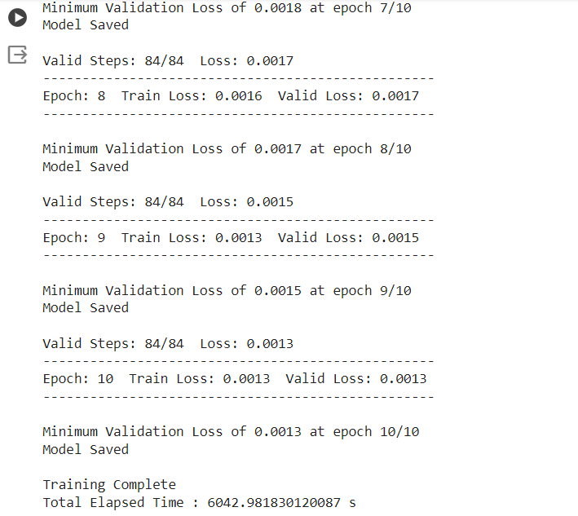
RESULTS (Training)
3/21/2024 Annual Review
10

Slide 11
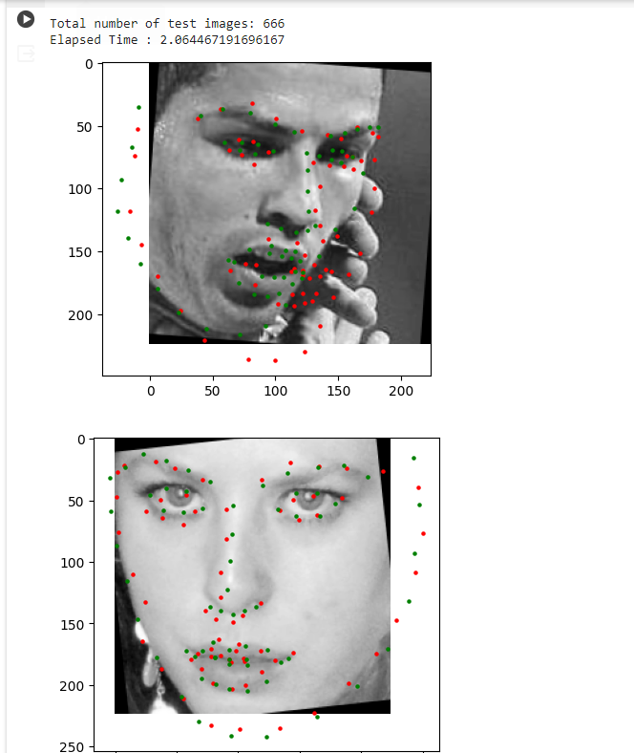
RESULTS (Prediction)
3/21/2024 Annual Review
11

Slide 12
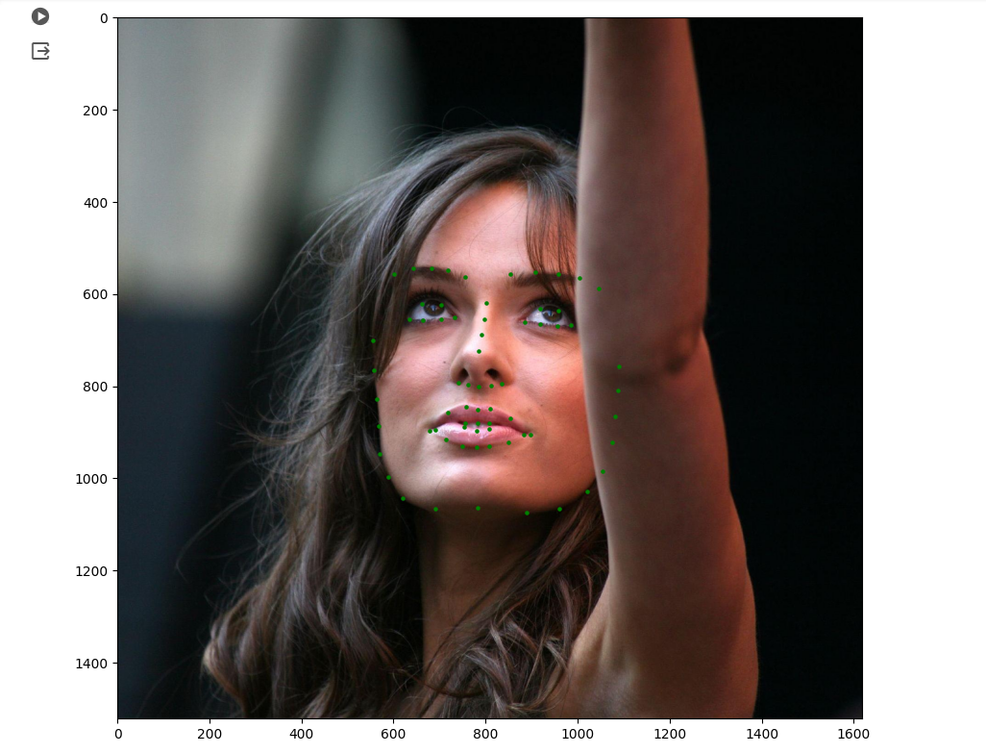
RESULTS (Visualization)
3/21/2024 Annual Review
12

